Slide 1
Interpretation and Analysis of Metacells generated by the SEACells Algorithm
Harshit and Marek

Slide 2
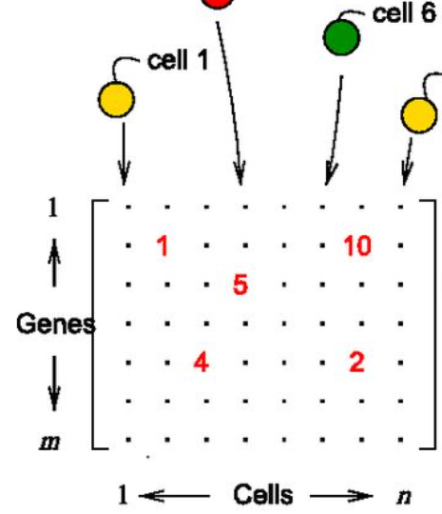
Introduction
Challenges of Single Cell Genomics
Sparse data matrix
Technical Batch Effects
No way to easily differentiate between technical noise and biological variation
Makes further downstream analysis difficult
Notes:
Single cell data is sparse(lowly expressed genes contribute to zeroes). Small fraction of desired reads are actually sequenced in any given single cell experiment. Thus, there is high uncertainty associated with any single cell experiment. Hence, results vary from experiment to experiment and also vary depending on the instrument used. Standardising protocols can reduce this, but still we only get to make the measurement once for a given cell.

Slide 3
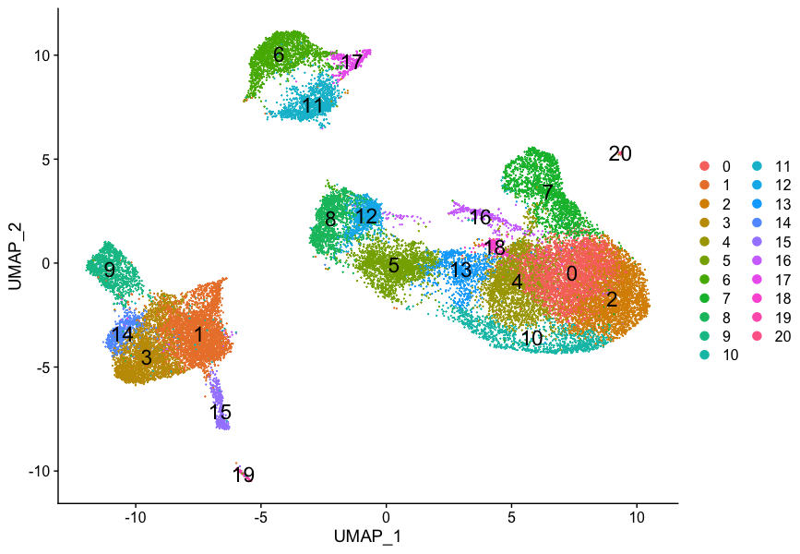
Handling Sparsity
Problems with existing cluster level analysis:
Clustering often ends up grouping different cell types together.
Non-homogeneity within cluster.
Single cell data resides on a continuum
MetaCells
Group of cells that represent distinct cell states whereby within metacell variation is due to technical rather than biological sources.
Are optimised for homogeneity within cell groups.
Notes:
Metacells (The concept)
How do meta cells solve the data sparsity problems. Advantages over traditional clustering. Problems with existing clustering methods. Why the need to solve this problem(enumerate!)
The measurements within a Metacell can be thought of as coming from the same distribution.

Slide 4
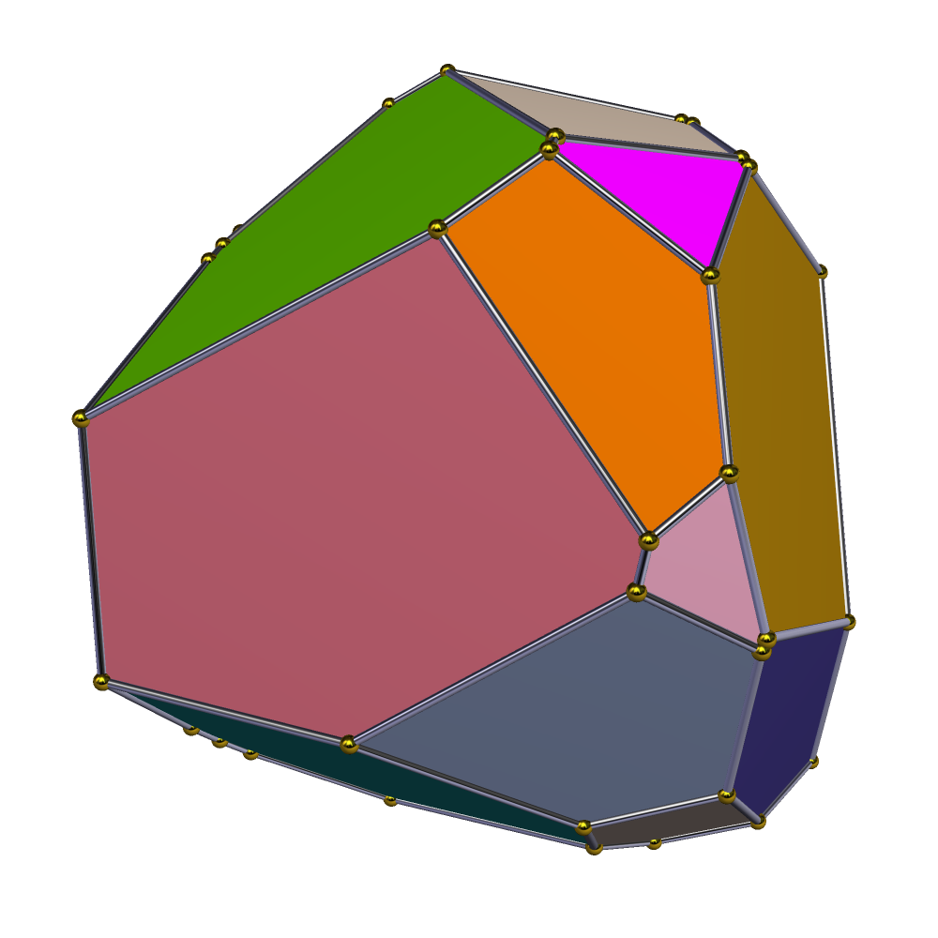
SEACells Algorithm
Assumptions:
Biological Systems consist of well-defined and finite sets of cell-states.
Inputs:
Raw count Matrices, low-dimensional representation of data, # of Metacells
Key steps:
kNN graph using Euclidean distances.
Affinity matrix of cell-to-cell similarities.
Kernel matrix bridging to archetypal analysis.
Identification of groupings results in the SEACells metacells.
Normalization of metacell count matrices opens up avenues for further analyses (clustering, visualization, data integration, trajectory inference, etc.)

Slide 5
Interpreting the different facets of the d-dimensional polytope
SEAcells algorithm identifies archetypes (metacells) in the single cell data.
The archetypes are vertices of a convex hull in d-dimensional space.
What defines (biological interpretation) an edge connecting two vertices or a plane defined by multiple vertices of the polytope?
Motivation
Currently the number of metacells is a parameter to the SEAcells algorithm.
We propose that a better understanding of the architecture of the convex hull would help us better optimize the number of metacells.

Slide 6
Requirements
Data: PBMC dataset as the characterized reference; Human Cell Atlas for test datasets.
Computing: Google Cloud, due to the number of calculations to be performed
Software packages: Scipy.spatial for spatial algorithms and data structures

Slide 7
Timeline & Milestones
by April 11: successfully representing the metacells as a convex polytope object. Create methods to manipulate this object.
by April 20: Evaluating model (methods) performance with reference dataset (already has well characterized cell states)
by April 26: Running the algorithm on new data and interpreting results.
In general, Harshit will perform data analysis and interpretation, while Marek will do the related coding.

Slide 8
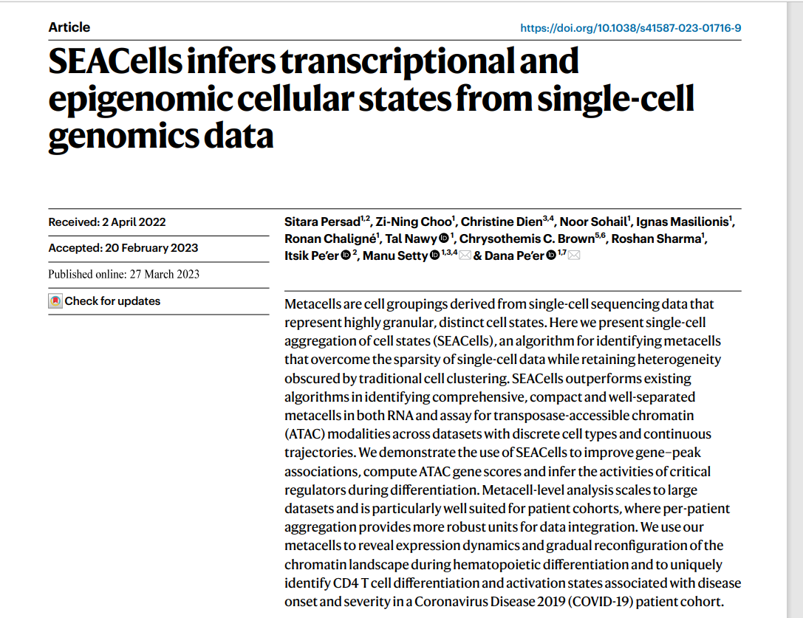
Reference

